Slide 1

Guide In Charge,
Mr. TJ Jobin
Presented By,
Tintu KL
MCA Reg –S5
Roll No:41

Slide 2
CONTENTS
Introduction
Kali Linux
Phishing
HiddenEye
Introduction To HiddenEye
Installation And Working
How To Prevent?
Conclusion
References

Slide 3
INTRODUCTION ON KALI LINUX
Debian-based Linux distribution aimed at advanced Penetration Testing and Security Auditing.
Release Date: March 13th, 2013.
Security-focused version of Linux that offers a large number of tools to seek out weaknesses and secure your network.
Kali contains several tools
Information security tasks
Penetration Testing, Security research
Computer Forensics and Reverse Engineering

Slide 4
Open source
600 penetration testing tools + Applications
Platforms - x86, x86-64, armel
Latest Release – Kali 2018.3
Easy upgrade to future versions

Slide 5
PHISHING
Phishing is the attempt to obtain sensitive information such as usernames, passwords, and credit card details
Phishing is typically carried out by email spoofing or instant messaging, and it often directs users to enter personal information at a fake website, the look and feel of which are identical to the legitimate one and the only difference is the URL of the website in concern.
Phishing emails may contain links to websites that are infected with malware.

Slide 6
HIDDENEYE
HiddenEye is a tool for perform phishing attacks. In this tool many social networking pages are available . ngrok allows you to expose a web server running on your local machine to the internet. It work just like other phishing framework, simply it takes credentials from users when they type confidential information like usernames, passwords, credit card-numbers and take that inputs and show you on terminal.

Slide 7
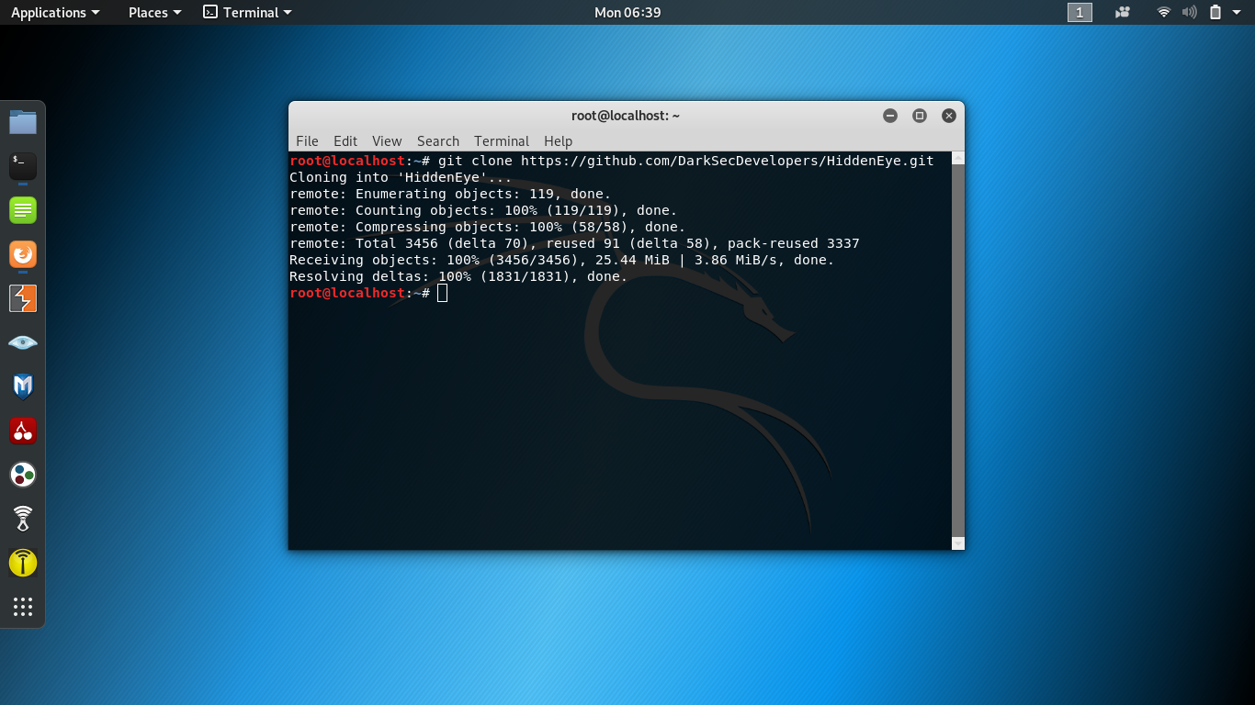
STEPS INSTALLATION AND WORKING
Step 1:
To install the HiddenEye on kalilinux we need to download it from the github, with the git clone command
git clone https://github.com/DarkSecDevelopers/HiddenEye

Slide 8
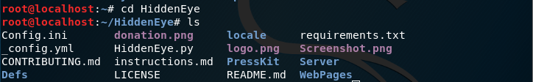
Move to the HiddenEye folder cd HiddenEye , List the files in it.

Slide 9

Step 2:
Execute the following command.
Pip3 install –r requirements.txt
“ sudo python3 HiddenEye.py ”

Slide 10
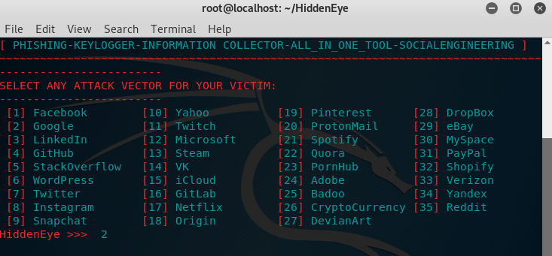
Step 3:
Select any Phishing page.

Slide 11
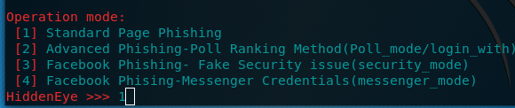
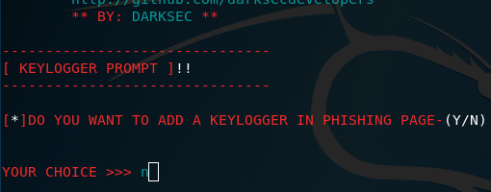
Step 4:
Select operation mode , key logger and cloudfare options.

Slide 12
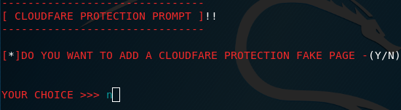
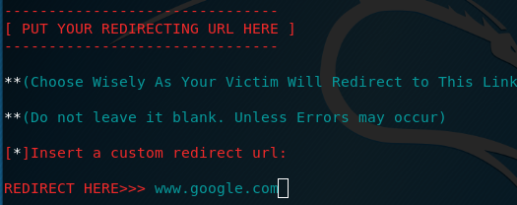
Step 5:
Insert a custom redirection URL.

Slide 13
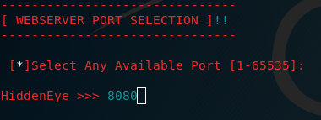
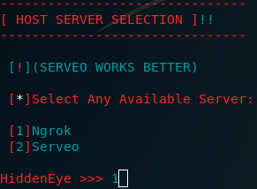
Step 6:
Select port number.
Step 7:
Select available Host Server

Slide 14
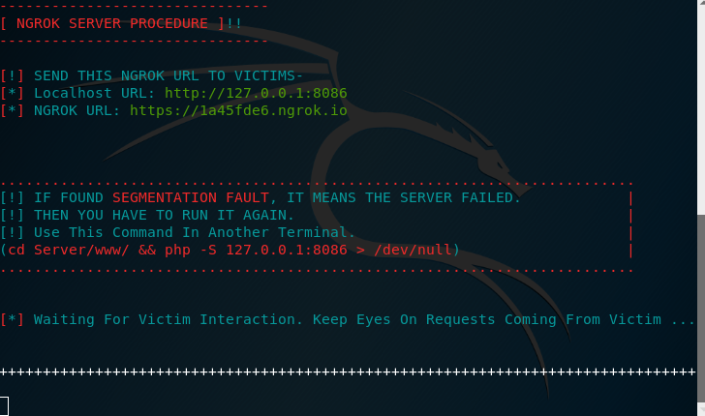
It create ngrok url.

Slide 15
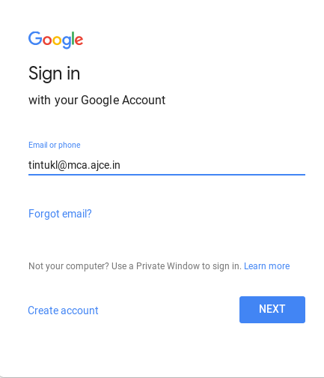
Step 8:
Copy this ngrok url and paste it on another browser window. When the victim clicks on the link, victim will redirect to the phishing page. If the victim enters any secret credentials on the page, the information will display on the HiddenEye terminal.

Slide 16
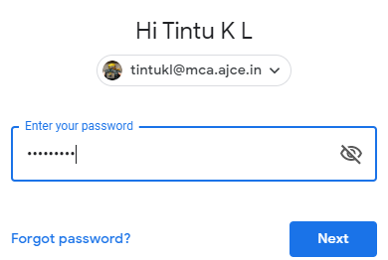

Slide 17
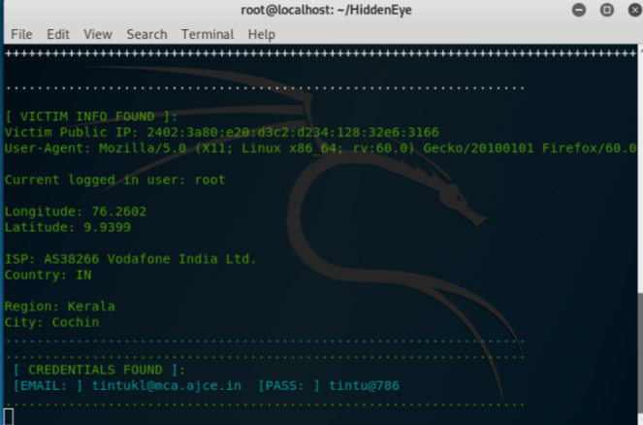
Step 9:
Login credentials and some device information of the victim are displayed.

Slide 18
HOW TO PREVENT?
Be suspicious of unsolicited phone calls, visits, or email messages from individuals asking about employees or other internal information.
Don't send sensitive information over the Internet before checking a website's security.
Pay attention to the URL of a website that may use a variation in spelling or a different domain (e.g., .com vs. .net).
Install and maintain anti-virus software, firewalls, and email filters to reduce some of this traffic.

Slide 19
CONCLUSION
Phishing is a growing crime and one that we must be aware of and HiddenEye is the most complete phishing tool. Although laws have been enacted, education is the best defense against phishing. Being a bit suspicious of all electronic communication and websites is recommended. Look out for the common characteristics- sense of urgency , request for verification , and grammar and spelling errors. Also , get in the habit of comparing the provided URL with an independent search for the company’s website. the main advantage in using HiddenEye is that it gives a realistic look to the phishing pages(eg, facebook, linkedin etc..). so that the victim is interested to do with that.

Slide 20
REFERENCE
https://github.com/DarkSecDevelopers/HiddenEye
https://youtu.be/aOJPwYQZn34?t=117
http://www.phishing.org/10-ways-to-avoid-phishing-scams

Slide 21
THANK YOU

